Slide 1
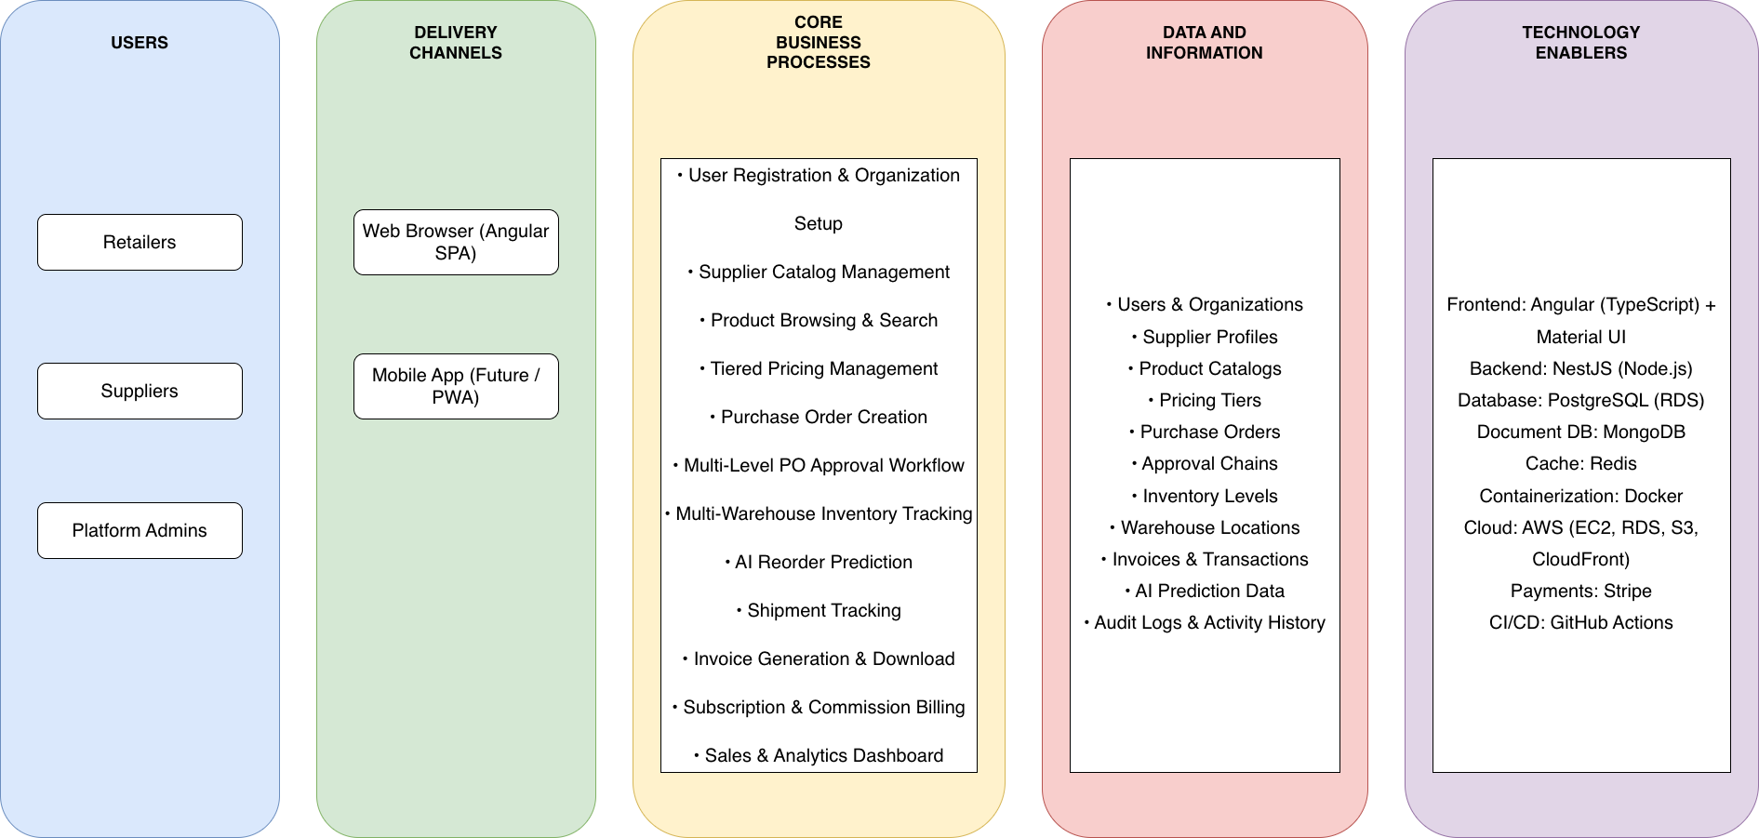
Application: BulkCart
Type: Application Architecture
View: Logical View
Style: Layered Architecture Pattern

Slide 2
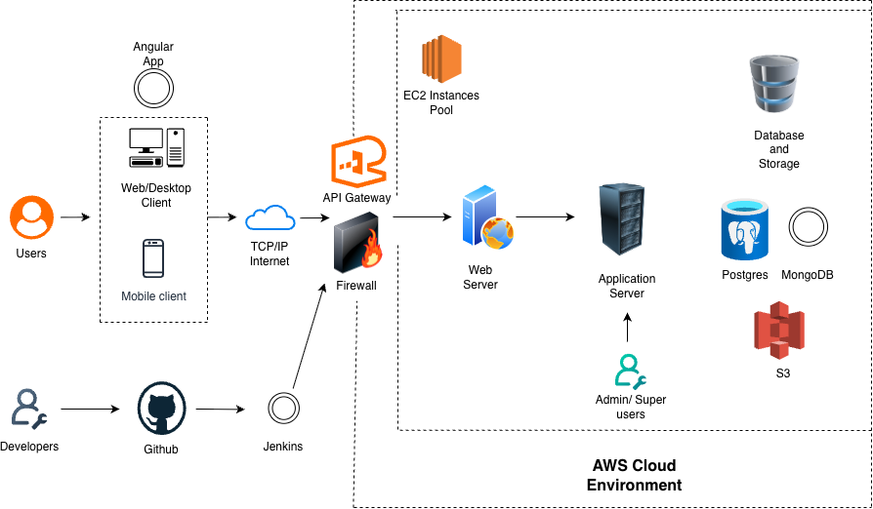



Application: BulkCart
Type: Application Architecture
Style: Client-Server Pattern
View: Process View

